Slide 1
MKTG 571:
Customer Loyalty
Designing and Managing a Loyalty Program Effectively

Slide 2
Today’s Agenda
To discuss successful versus unsuccessful loyalty programs
To show how to design an effective loyalty program
To discuss the evolution of loyalty programs and the challenges faced in designing loyalty programs

Slide 3
The Ideal Customer-Firm Relationship
The customer is constantly investing in the firm
The firm recognizes the customer’s value
Value Captured
Customer benefits
increase over time
Firm profits
increase over time
FIRM
Value Created
The customer recognizes the firm’s value
The firm is constantly investing in the customer

Slide 4
Rewards Programs Can Help
Emotional bonds are strengthened
Customer information is captured
Value Captured
Customer benefits
Firm
profits
FIRM
Value Created
Extra incentives to buy
Interactions become customized

Slide 5




Types of Customer Loyalty
Forced Monopoly
Ends with choice
Habitual Purchase without thought
Bought Bribe offered
Emotional Believe chosen product or firm is best for them
Takeaway: “Loyalty” is complex

Slide 6
Satisfaction-Loyalty-Profitability
What do we know about the link between customer satisfaction and customer loyalty?
What about the link between customer loyalty and customer profitability?

Slide 7
Loyalty Expectations
We expect loyal customers to:
  Spend more per period over time
  Cost less to serve per period over time
  Have greater propensity to generate word-of-mouth
  Pay a price premium when compared to short-term customers

Slide 8
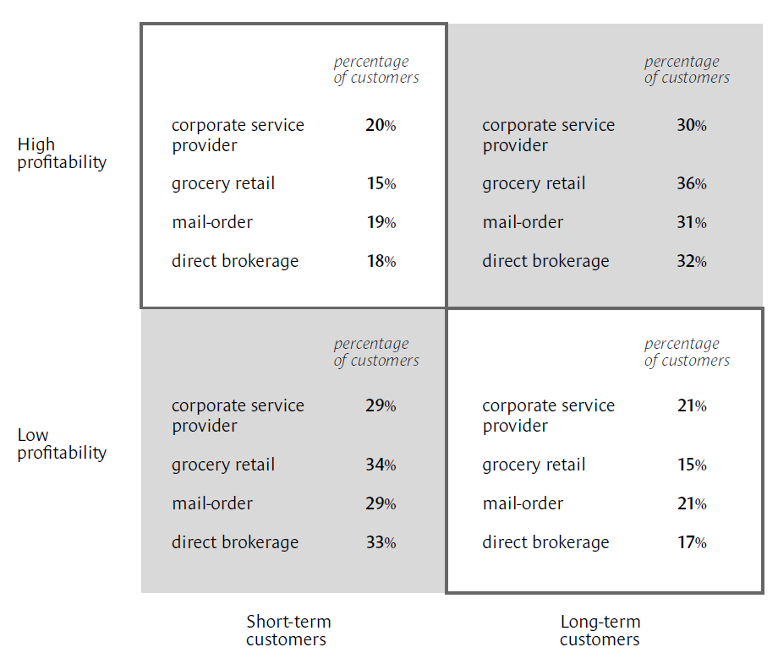
Loyalty x Profitability
What did the study by Reinartz and Kumar (2002) find as the relationship between behavioral loyalty and profitability?

Slide 9
Loyalty Definitions
Does it matter how we define customer loyalty?
  Attitudinal Loyalty?
  Behavioral Loyalty?
  Is one more strongly linked to customer profitability?

Slide 10
Loyalty Programs
Key Objectives:
  Building ‘true’ loyalty
  Increasing profit efficiency
  Increasing profit effectiveness
  Aligning value between the firm and its customers

Slide 11
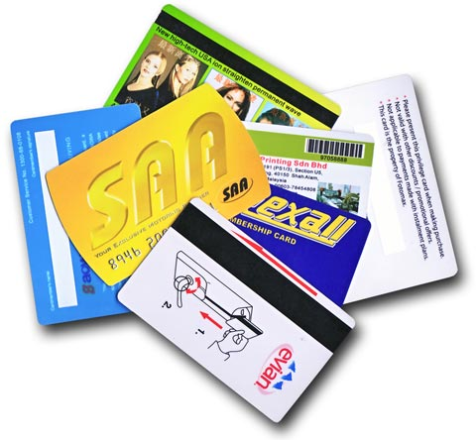
Loyalty Programs:
What’s in your wallet?

Slide 12
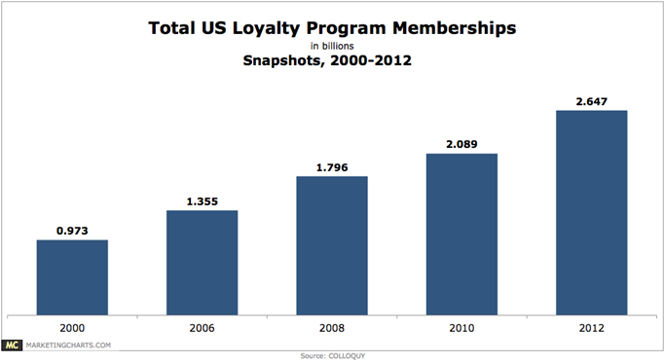
Loyalty Programs Membership
US customers participate in 29 loyalty programs on average (actively participate in 13 programs) (COLLOQUY Loyalty Census 2015)

Slide 13
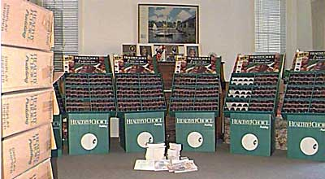
The ‘Pudding Guy” Demonstrates Counter-productive Behavior
Healthy Choice promotion offered American Airline miles in return for UPC codes
David Phillips – engineer at UC-Davis did the math:
  Bought 12,150 cups of chocolate pudding
  Redeemed for 1,253,000 miles
  Cost: $3140 - $815 (tax deduction for donating the pudding to charity) = $2325
  Has Gold status for life on
  American Airlines
Followed up with Latin Pass
offer : 1 million miles for flying
10 Latin American airlines …

Slide 14
Designing a Program
What are the key characteristics:
  Reward Structure
  Sponsorship

Slide 15
Reward Structure
Hard vs. Soft Characteristics
Product Proposition Support
Aspirational Value of Reward
Rate of Rewards
Tiering of Rewards
Timing of Rewards

Slide 16
Reward Structure
 | Intrinsic (adds value to core offering) | Extrinsic (external to core offering)
Hard | Discounts Upgrades | Redeem miles for magazines Shop for 12 weeks and get luggage
Soft | Special recognition Membership in elite club Special hours/events Priority reservations | Celebrity meet and greet

Slide 17
Sponsorship
Single vs. Multi-firm Program
Within Sector/Across Sector
Ownership of Program

Slide 18
Loyalty Programs
Three key questions must be answered:
From the customer’s perspective, are the rewards attainable?
From the customer’s perspective, are the rewards relevant?
From the firm’s perspective, is the loyalty program design aligned with desired goal(s)?

Slide 19
Reward Program Examples
Best vs. Worst
  What are your favorite reward programs?
  What are your least favorite reward programs?
  What are the attributes you like most/least?

Slide 20
A Gold Standard
Harrah’s Total Rewards:
  Membership is free
  You can use the card at any of Harrah’s casinos and resorts
  You earn rewards by spending money through gambling, hotel stays, etc. (and the rewards are given based on two tiers – same for revenue; additional rewards for profits)
  You earn status and differentiated benefits at different tiers
  You can spend your rewards on services at Harrah’s, you can shop at the Total Marketplace, or special experiences
  The program partners with other sponsors (e.g. VISA)

Slide 21
A Framework
To Manage Loyalty Programs Profitability:
  Build and enhance behavioral loyalty
  Cultivate attitudinal loyalty
  Link loyalty and profitability

Slide 22
A Framework
Building Loyalty
Tier 1 Reward
Behavior Analysis
Attitude Analysis
Customer Profile Information
CLV
Score
Building Behavioral Loyalty
Cultivating Attitudinal Loyalty
(encouraging WOM and Referrals)
Linking Loyalty
to Profitability
Tier 2 Reward
Determine Reward Objective
Determine Type of Reward
Sustaining Loyalty (Across Select Customers)
Source: Kumar (2008)

Slide 23
Operationalizing the Framework
Cell 4 | Cell 1
Cell 3 | Cell 2
High
Cultivate Attitudinal Loyalty
Purchase Behavior
Low
Encourage Spend/Frequency
Low
High
Profitability

Slide 24
Operationalizing the Framework
A Two-Tier Reward Strategy:
Tier 1 Rewards:
  A Baseline Rewards Approach
  Collecting Customer Transaction Data
  Ensuring Scalability of the Loyalty Programs

Slide 25
Operationalizing the Framework
A Two-Tier Reward Strategy:
Tier 2 Rewards:
  Forward-looking (influence future attitudes and behaviors)
  Selective:
    Who should be rewarded?
    What type of reward should be given?
    How much should the reward be worth?

Slide 26
Polygamous Loyalty?
The goal of loyalty programs is to keep customers engaged with a firm.
They are based on the premise that rewards will motivate
customers to continue transacting with the firm and reduce transactions with competing firms.
But, customers are typically not 100% loyal to one firm and make purchases across several firms. This behavior is referred to as “polygamous loyalty”.
So, what happens when a customer redeems a reward?
Stay loyal to the focal firm?
Reward redemption
at focal firm
Seize the opportunity to
shop across other firms?

Slide 27
Study Design
How does loyalty program usage [i.e., Reward redemption] at a given firm impact a customer’s future behavior at the focal firm and future behavior with competing firms?
Search & Purchase
at Focal Firm
Reward Redemption
at Focal Firm
Future Search & Purchase at Focal Firm
Search & Purchase across Other Firms
Future Search & Purchase across Other Firms

Slide 28
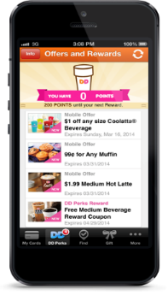
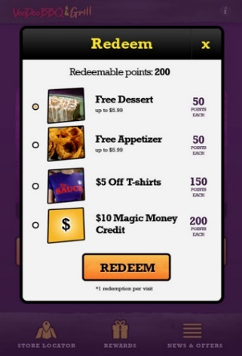
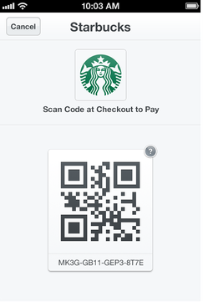
Context of Study
Loyalty program mobile app
Loyalty programs in restaurant industry
  - 54 million members (COLLOQUY Loyalty Census 2015)
  - High membership growth rate
Our study is applicable to any other industry in which customers make frequent purchases across competing firms
Search
(Reward options)
Purchase
(Frequency & Monetary Value)

Slide 29
Sampling of Customers
Transaction and search data for six restaurants in close geographical location
Observation period: July 2011-March 2013
Multiple reward options at each restaurant
2,051 total customers
699 redeemed at least one
reward at one of the six
restaurants
Three customer types
observed in the
data: Customers A, B, and C
We use propensity score matching
of Customers A and B to create
a matched sample of Redeemers
and Non-redeemers for Study 1
and Study 2 to control for self-
selection
Search
Buy
Search
Buy
Redeem
Customer A
Redeemer
Join
Search
Buy
Buy
Search
End
Before Redemption
After Redemption
Search
Buy
Expected Redeem
Search
Buy
Customer B
Non-redeemer
Join
Search
Buy
Buy
Search
Buy
End
Before Redemption
After Expected Redemption
Search
Buy
Expected Redeem
Customer C
Join
Search
Buy
End

Slide 30
Study 1: The Impact of Customer Reward Redemption on Customer Behavior
Setup:
Our study aims to evaluate the effect of reward redemption on customer search and purchase behavior after that customer redeems a loyalty program reward. However, we need to control for how a redeemer would have behaved differently had she not redeemed a reward.
We use propensity score matching to create a pseudo-random experimental setting where we match redeemers (treatment) and non-redeemers (control) with similar characteristics pre-redemption.
For both redeemer and non-redeemer customers we estimate the post-redemption model for a period of eight weeks after redemption. We jointly estimate a customer’s post-redemption search and purchase behavior at the focal firm and across competing firms. We control for customers’ pre-redemption search and purchase behavior, customers’ variety seeking tendency, and differences across firms (using firm fixed effects).
Findings:
Customers who redeemed a reward at one firm will search more for rewards and purchase more (compared to those who did not redeem any reward) post redemption, both at the focal firm and across other firms.
+
Search & Purchase
at Focal Firm
Reward Redemption
at Focal Firm
Future Search & Purchase at Focal Firm
+
Search & Purchase across Other Firms
Future Search & Purchase across Other Firms

Slide 31
Study 2: Decomposition of the Reward Redemption Effect
Setup:
In Study 2, we focus on redeemer group. We decompose the reward redemption effect into three theoretically-driven mechanisms to better understand what types of reward redemption characteristics and customer behaviors lead to increases in customer search and purchase behavior at the focal firm and across competing firms.
1. Rewarded Behavior Effect: Larger the reward, the more the customer is motivated to get more rewards
2. Point Pressure Effect: Customers are likely to increase search and purchase behavior as they get closer to a reward
3. Effort-balancing Effect: More effort to get a reward, the more likely the customer will rebalance efforts to achieve other rewards
Rewarded Behavior Effect
+
+
+
-
Customer Behavior at the Focal Firm
Customer Behavior across Competing Firms
-
Effort-balancing Effect
+
+
-
Point Pressure Effect

Slide 32
Managerial Implications
  Loyalty Program Design
  Target consumers with messages that highlight the points remaining towards the next goal, especially when the reward is large.
  Provide consumers with discounts for accelerating their purchases and achieving the goal of larger rewards faster.
  Encourage the redemption of larger rewards (e.g., through reminders) for consumers who exhibited purchase acceleration to qualify for the reward
  Offer customers the chance to redeem rewards that are well below the customer’s current reward point balances.
  Consider other options to increase point pressure after a reward redemption
    e.g., giving customers points back when the customer redeems a reward to keep them close to the next reward goal)
  Consider increasing the points collection rate for customers post-redemption.

Slide 33
The Evolving Loyalty Program
Dimension | Earlier Loyalty Programs | Evolving Loyalty Programs
Operationalization Level | Aggregate | Customer Level
Program Type | Standardized on Usage/Spend | Customized on Type of Usage/Spend
Rewarding Scheme | Standard and Uniform (aimed at repeat purchase) | Personalized and Relevant (aimed at behavior/attitude)
Reward Options | Minimal | Multiple (usually through partners/alliances)
Reward Mechanisms | Reactive | Reactive & Proactive
Reward Types | Tangible | Tangible & Experiential
Program Objectives | Build market share, increase revenue, build behavioral loyalty | Link loyalty to profitability, influence behavioral loyalty, & cultivate attitudinal loyalty
Metrics Used | RFM, PCV, SOW | CLV
Technology and Analytics | Minimal | Extensive

Slide 34
Operationalizing the Framework
Challenges:
  The ability to discriminate customers on Purchasing Behavior, Attitudes, Profile, and Profitability Potential without alienating customers
  The ability to build and sustain loyalty without sacrificing profitability

Slide 35
For Next Class
Topic:
  Introduction to Customer Metrics
Reading:
  Choosing the Right Metrics to Maximize Profitability and Shareholder Value (download)
Assignment:
  Individual: Predicting Response at BookBinders: Decision Trees

